Slide 1
Database Creation procedure
Sowmiya Murugiah
50485124

Slide 2
Road Map
Overview
Flowchart
Flowchart Description
Data Manipulation
Database Creation
Table Description
Table Creation Query
Insert Query
Query To Retrieve Data
Conclusion

Slide 3
Overview
The purpose of this presentation is to illustrate the significance of storing WiFi details in a database and to outline the objectives behind creating a dedicated database system for WiFi information.
Database Creation for WiFi Details: It focuses on demonstrating the process of designing and implementing a database specifically tailored to store and manage WiFi-related information efficiently.
To create a centralized repository for storing crucial WiFi details like MAC addresses (BSSID), signal strength (RSSI), SSID, frequency, and related metadata.
To ensure easy access, retrieval, and management of WiFi-related information for network optimization and troubleshooting purposes.

Slide 4
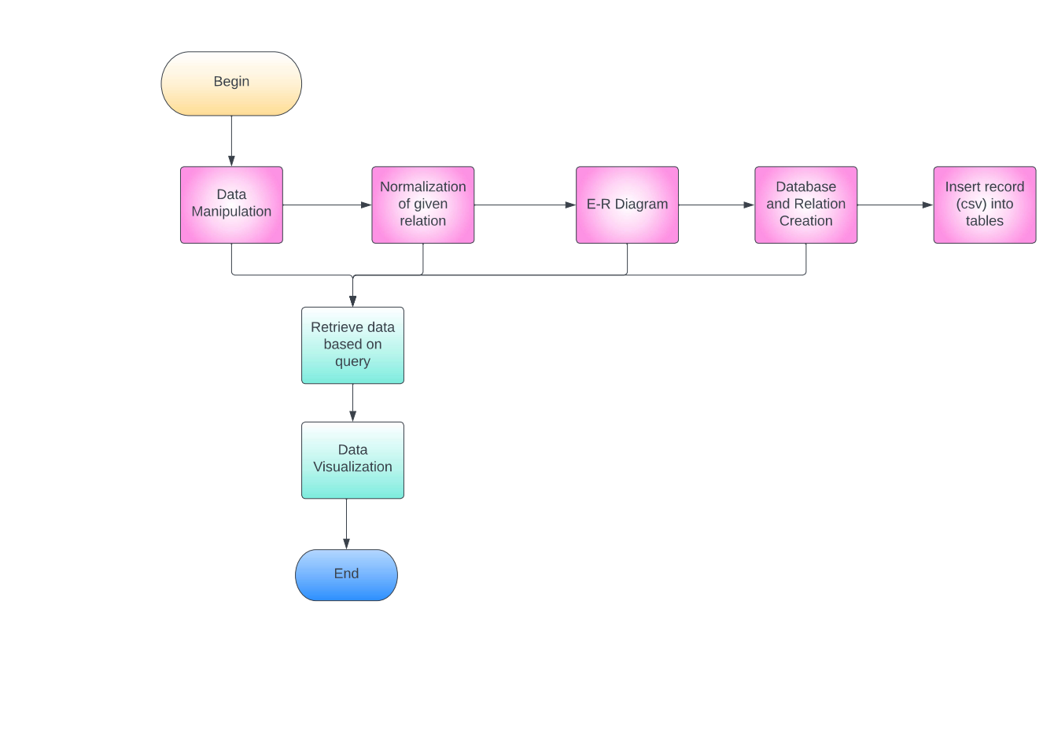
Flowchart

Slide 5
Flowchart Description
1. Define the purpose and scope of the database: The first step in creating a database is to define its purpose and scope. This will help you determine the tables and relationships needed to store the data.
2. Design the data model: After defining the purpose and scope of the database, the next step is to design the data model. This involves identifying the tables needed to store the data, their relationships, and the attributes or fields for each table.
3. Normalize the tables: Before creating the tables in the database, it is important to normalize them to eliminate redundancy and ensure data consistency. This involves breaking down tables into smaller, more manageable tables and establishing relationships between them.
4. Create the database: Once the tables have been designed and normalized, the next step is to create the database. This involves selecting a database management system (DBMS) and creating the database using the appropriate tools or programming language.

Slide 6
Flowchart Description
5. Create the tables: After creating the database, the next step is to create the tables. This involves defining the structure of each table, including its name, fields, data types, and constraints.
6. Insert records into the tables: Once the tables have been created, the next step is to insert records into them. This involves manipulating the data to make it ready for insertion into the database, such as cleaning and formatting the data.
7. Execute insert statements: Finally, the records can be inserted into the tables using SQL insert statements or other programming languages. This involves writing code that specifies the data to be inserted and the target table.

Slide 7
Data Manipulation
Data manipulation refers to the process of cleaning, transforming, and preparing data for storage in a database. This process is important because it ensures that the data is accurate, consistent, and formatted correctly before it is inserted into a database.
One important aspect of data manipulation is ensuring that the data is ready to be inserted into the database. This involves several steps, including ensuring that the column names are proper and do not contain any special characters that are not allowed in the database.
For example, when creating tables in a database, column names must follow certain rules and restrictions. Typically, column names should be short, descriptive, and avoid using special characters like '/', '', and so on. This is because these symbols have special meanings in SQL and can cause errors when used in column names.

Slide 8
Data Manipulation
To ensure that the column names are proper, you should carefully review the data and identify any columns that have special characters or other issues that need to be addressed. You can then modify the column names as needed to ensure that they comply with the database's requirements.
In addition to column names, data manipulation may also involve other tasks such as cleaning the data, removing duplicates, and converting data types. This is often done using programming languages or tools like Excel, Python, or SQL.
Overall, data manipulation is a critical step in preparing data for storage in a database. By ensuring that the data is formatted correctly and ready for insertion, you can improve the accuracy and consistency of the data and ensure that it is easily searchable and accessible.

Slide 9
Database and Table Creation
A postgreSQL database is a relational database management system that provides a robust and flexible platform for storing and managing data. In this case, a postgreSQL database is being used to store the Wifi data obtained.
To create the postgreSQL database, a query is used. This query is a set of commands that specifies the structure of the database, such as the tables and columns that will store the data. The query is executed by a program or software tool that interacts with the postgreSQL server to create the database.

Slide 10
Database and Table Creation
The query used to create the postgreSQL database will typically include information such as the database name, user credentials, table schema, and data types for each column. It will also specify any primary keys, indexes, or constraints that are required for data integrity.
Once the database has been created, data can be stored in it using insert queries or imported from external sources. The database can then be queried to retrieve the data for analysis, using commands such as select, join, and group by.

Slide 11
Database Creation
CREATE DATABASE "Wifi_Details"
WITH
OWNER = postgres
ENCODING = 'UTF8'
LC_COLLATE = 'English_United States.1252'
LC_CTYPE = 'English_United States.1252'
TABLESPACE = pg_default
CONNECTION LIMIT = -1
IS_TEMPLATE = False;

Slide 12
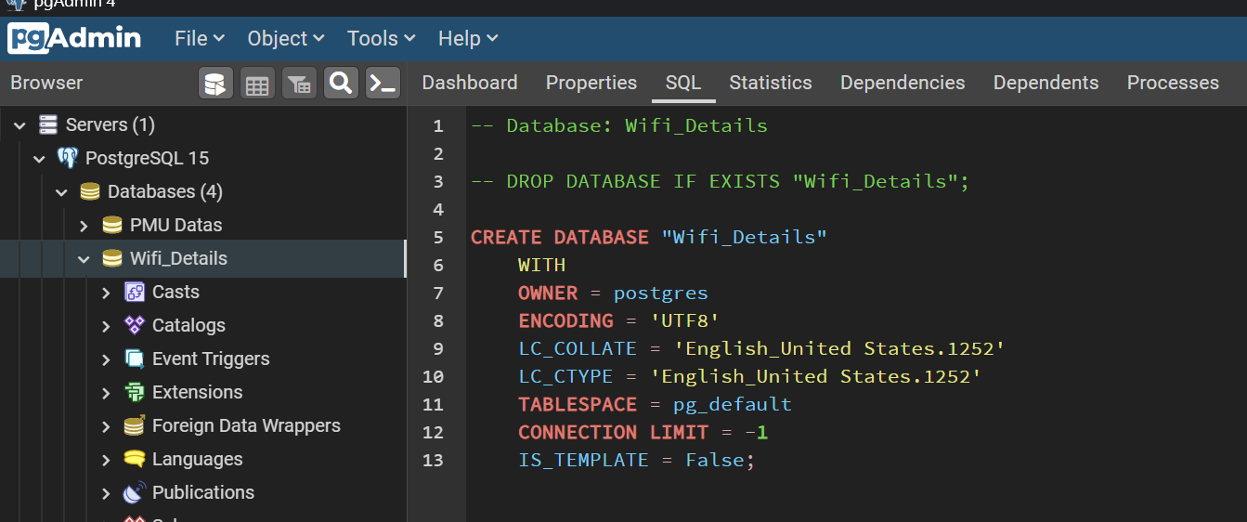
Database Creation
The below query is used to create database : “Wifi_Details”

Slide 13
Table Description
Wifi_Details Table:
wifi_id: Unique identifier for each WiFi entry (Primary Key).
timestamp: Time when the information was recorded.
BSSID: MAC address of the WiFi access point.
SSID: Service Set Identifier (Name of the WiFi network).
RSSI: Received Signal Strength Indication.
frequency: Frequency of the WiFi signal.
channel: Channel number of the WiFi network.

Slide 14
Table Description
Connected_DevicesTable:
connection_id: Unique identifier for each connected device entry (Primary Key).
timestamp: Time when the connection was made.
device_mac: MAC address of the connected device.
BSSID: Foreign Key referencing Wifi_Details table, indicating the MAC address of the WiFi access point the device is connected to.

Slide 15
CREATE TABLE Wifi_Details (
wifi_id SERIAL PRIMARY KEY,
timestamp TIMESTAMP NOT NULL,
BSSID VARCHAR (17) UNIQUE NOT NULL, SSID VARCHAR (50),
RSSI INTEGER, frequency FLOAT,
channel INTEGER);

Slide 16
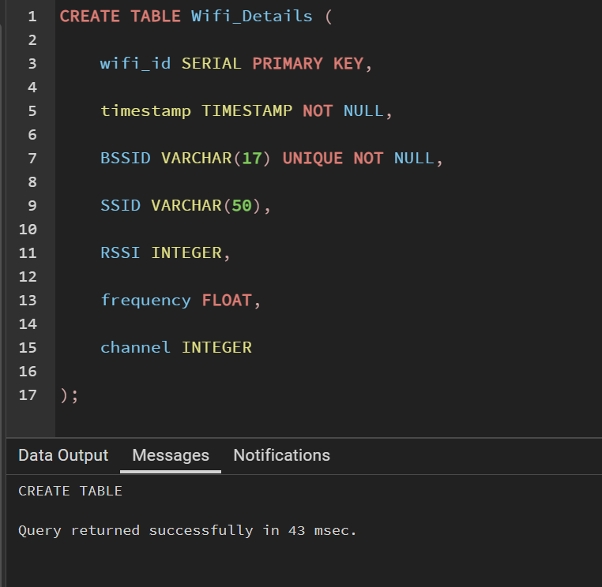
Table Creation Query – Wifi Details table

Slide 17
CREATE TABLE device_details (
id SERIAL PRIMARY KEY,
device_name VARCHAR(255),
address_family VARCHAR(255),
ip_address VARCHAR(255),
netmask VARCHAR(255),
broadcast VARCHAR(255),
mac_address VARCHAR(255)
);

Slide 18
CREATE TABLE Connected_Devices (
connection_id SERIAL PRIMARY KEY,
timestamp TIMESTAMP NOT NULL,
device_mac VARCHAR (17) NOT NULL,
BSSID VARCHAR (17) REFERENCES Wifi_Details(BSSIDD)
);

Slide 19
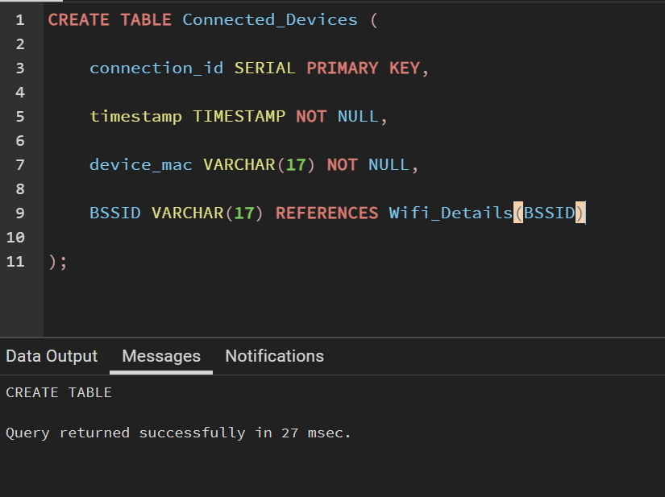
Table Creation Query – Connected Devices table

Slide 20
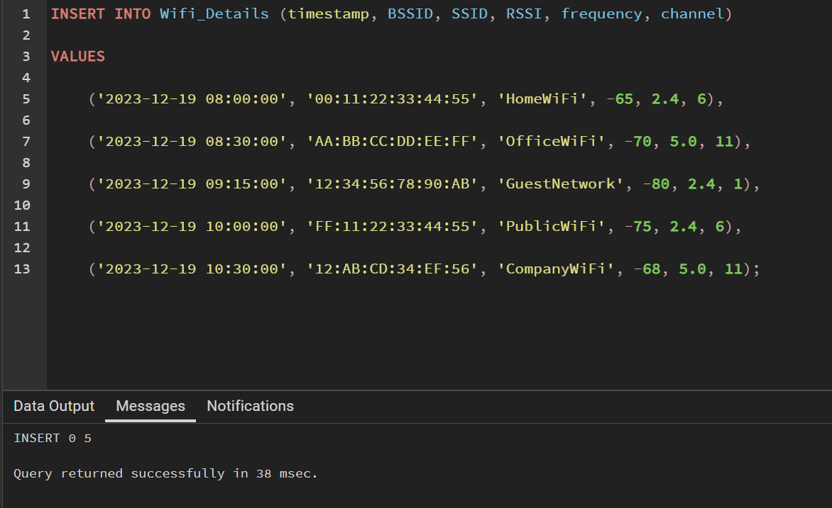
Insert query

Slide 21
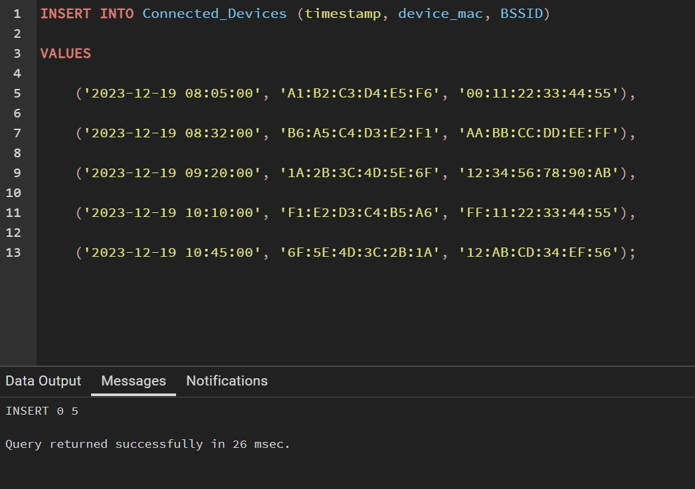
Insert query

Slide 22
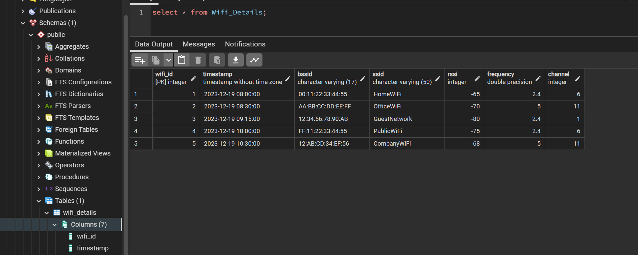
Query To Retrieve Data
Select query helps in retrieving the existing records from the table. The query for both the tables are shown below:

Slide 23
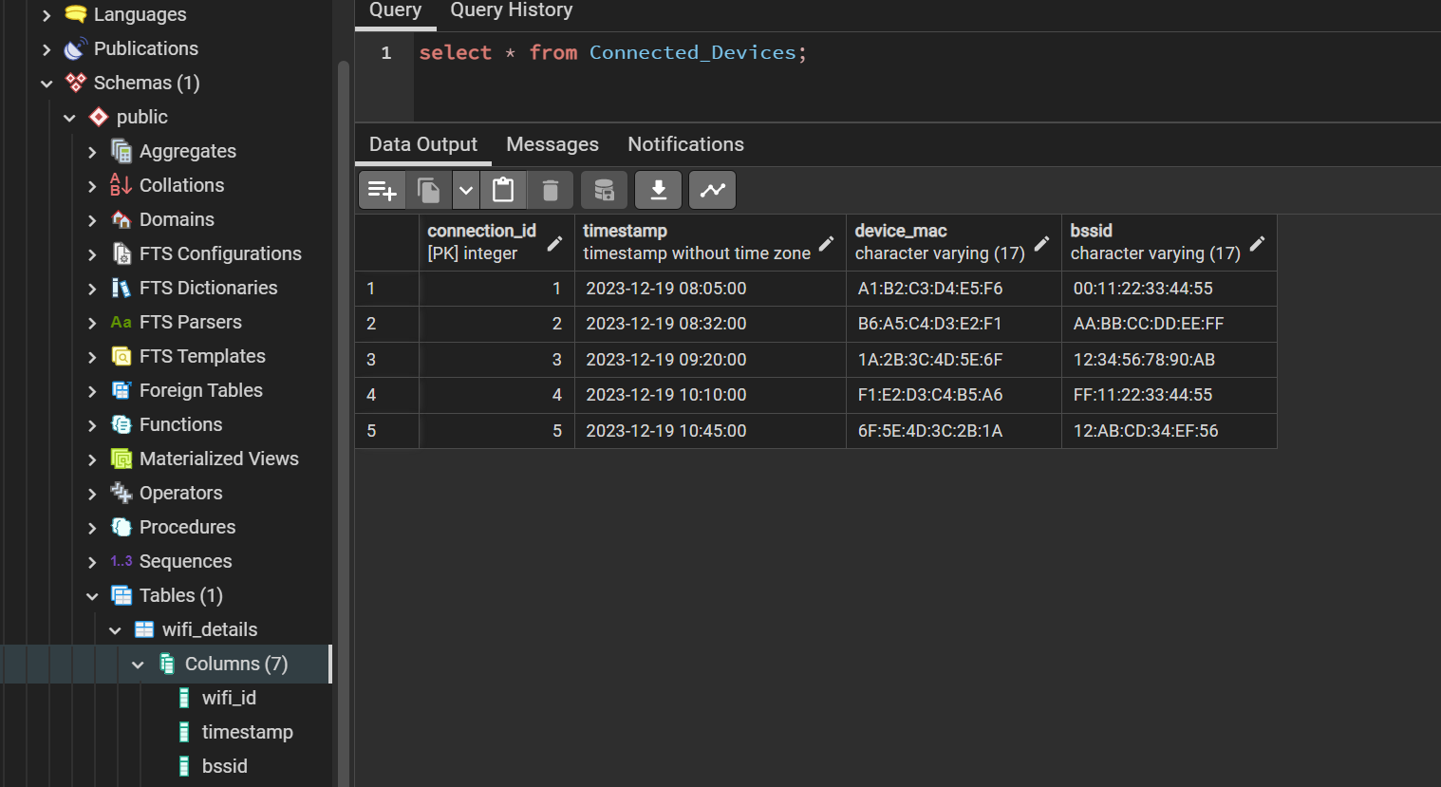
Query To Retrieve Data

Slide 24
Conclusion
In general, the database is set up with two relationships and information is loaded into the tables.
Sample datas are inserted into both the tables.
Next Step:
To add extra table and fields if required
To fetch real time data and to populate the tables

